Slide 1
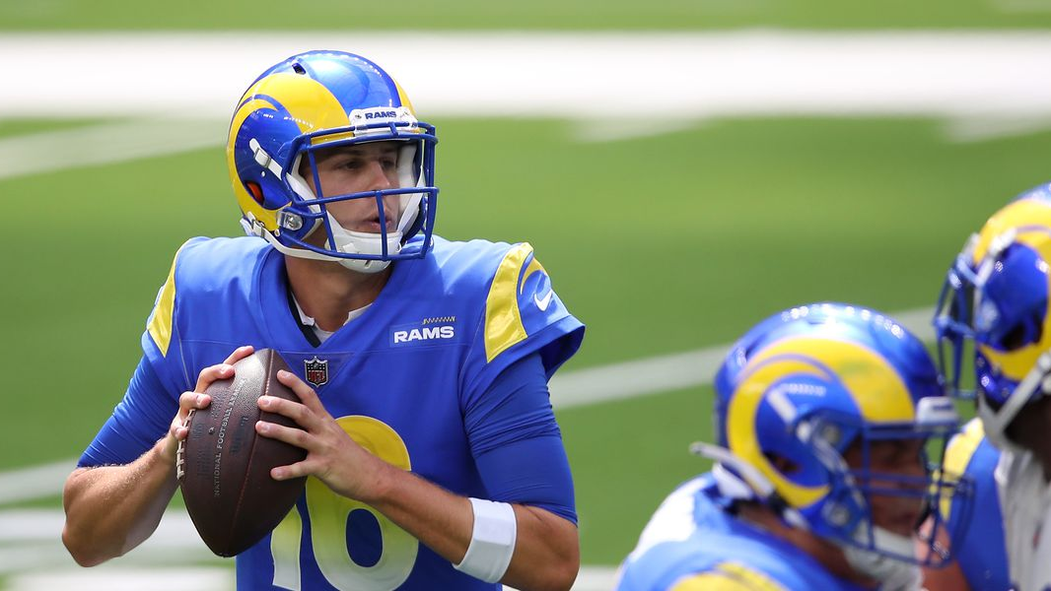

LA Rams Performance Analysis
Kevin O'Donnell, Tim Noel, Tim Brown
This Photo by Unknown author is licensed under CC BY-ND.
Notes:
Tim B

Slide 2
Chosen KPIs
KPI | Correlation with Win Percentage
EPA per Pass: | 0.756
Redzone TD Percentage: | 0.586
Defensive EPA per Pass: | 0.519
EPA per Rush: | 0.457
Defensive EPA per Rush: | 0.240
Notes:
Tim B

Slide 3

Rams Fall Off By The Numbers
Year | 2020 | 2021 | 2022
Record(Win Pct): | 10-6(.625) | 12-5(.706) | 5-12(.294)
EPA per Pass: | 0.033 | 0.184 | -0.096
EPA per Rush: | -0.081 | -0.089 | -0.062
Defensive EPA per Pass: | .15 | -0.03 | -0.095
Defensive EPA per Rush: | .192 | .113 | .099
Redzone TD Percentage: | 0.559 | 0.597 | 0.556
Notes:
Tim B

Slide 4
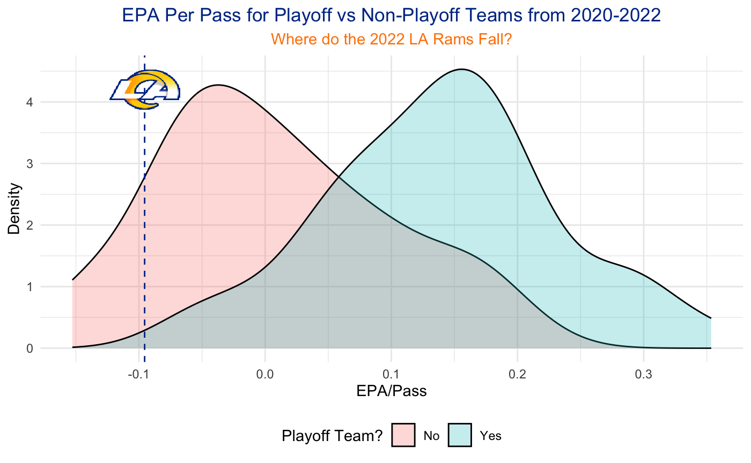
Playoff vs Non-Playoff Pass EPA
Team | Mean EPA Per Pass
Rams | −0.096
Playoff Teams | 0.108
Notes:
Kevin

Slide 5
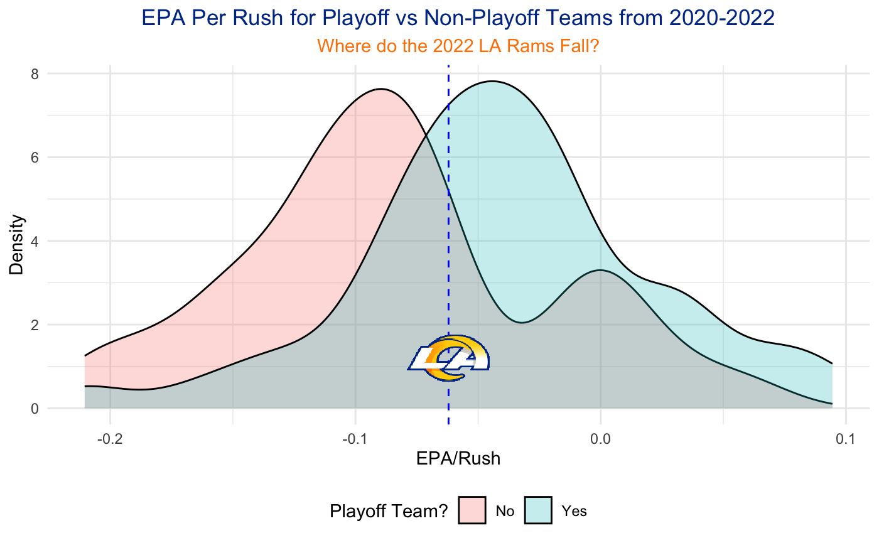
Playoff vs Non-Playoff Rush EPA
Team | Mean EPA Per Rush
Rams | −0.062
Playoff Teams | −0.051
Notes:
Kevin

Slide 6
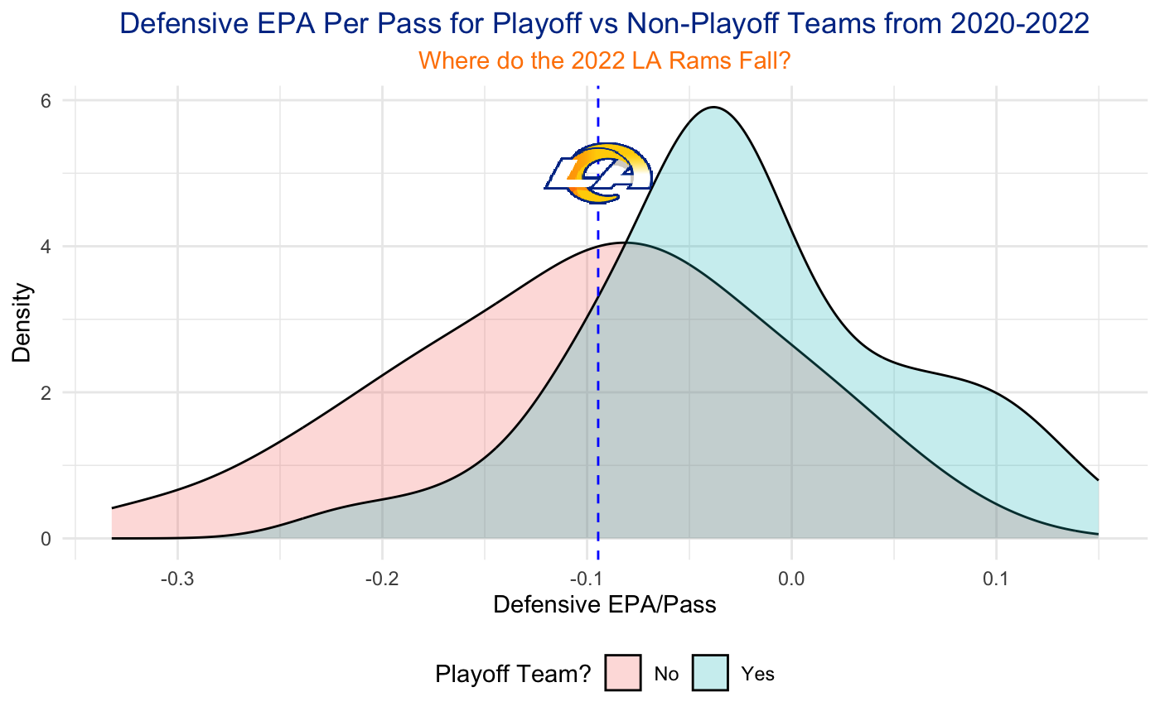
Playoff vs Non-Playoff Defensive Pass EPA
Team | Mean Defensive EPA Per Pass
Rams | −0.095
Playoff Teams | −0.008
Notes:
Tim N

Slide 7
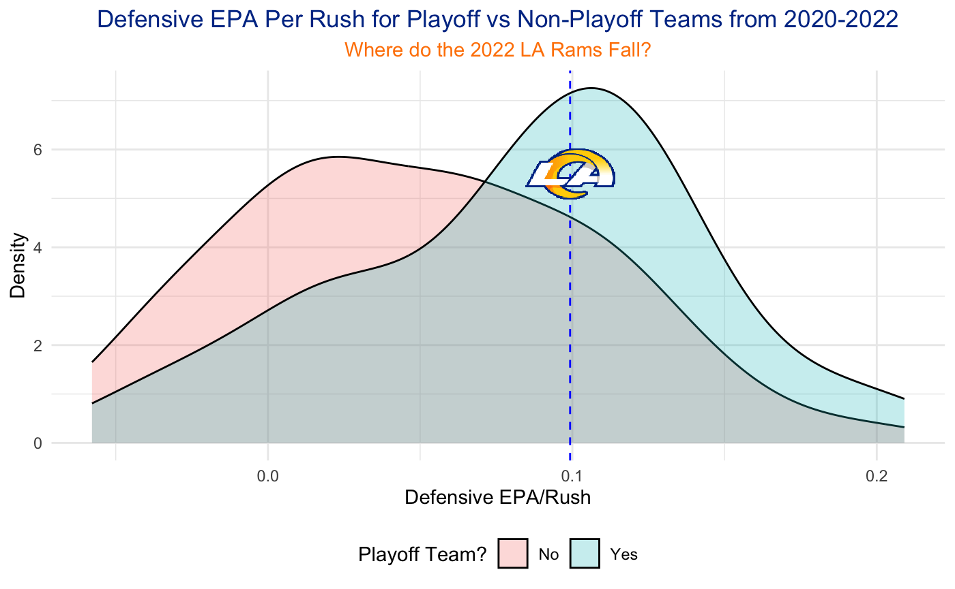
Playoff vs Non-Playoff Defensive Rush EPA
Team | Mean Defensive EPA Per Rush
Rams | 0.099
Playoff Teams | 0.071
Notes:
Tim N

Slide 8
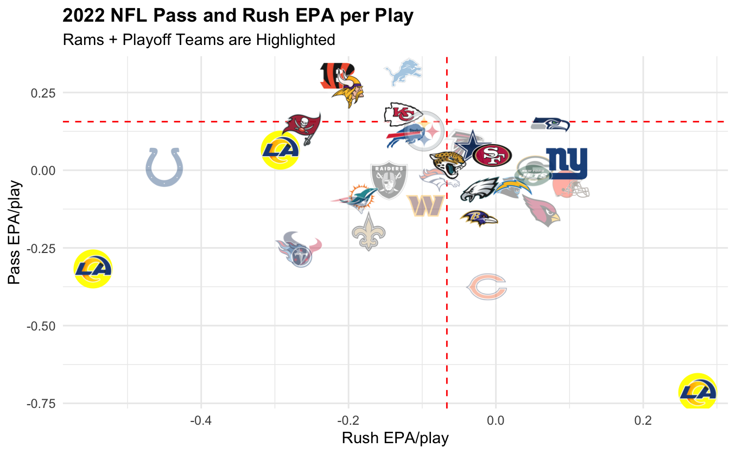
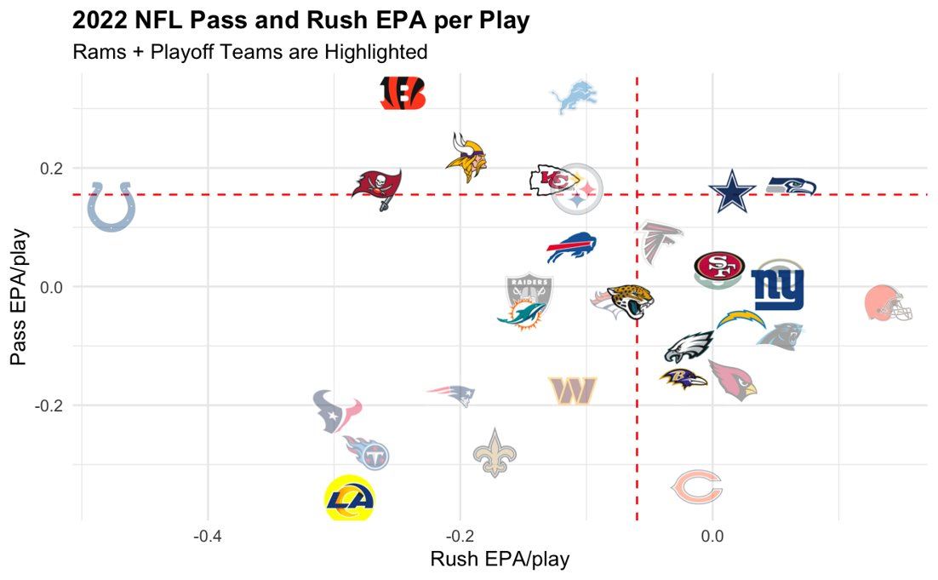
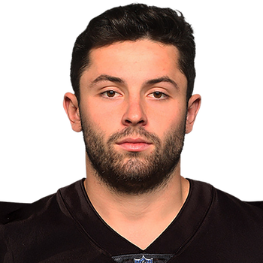
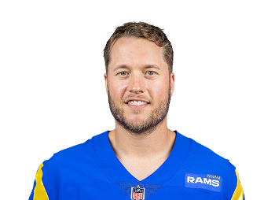

4th Quarter Crunch Time Offense
Notes:
Tim N

Slide 9
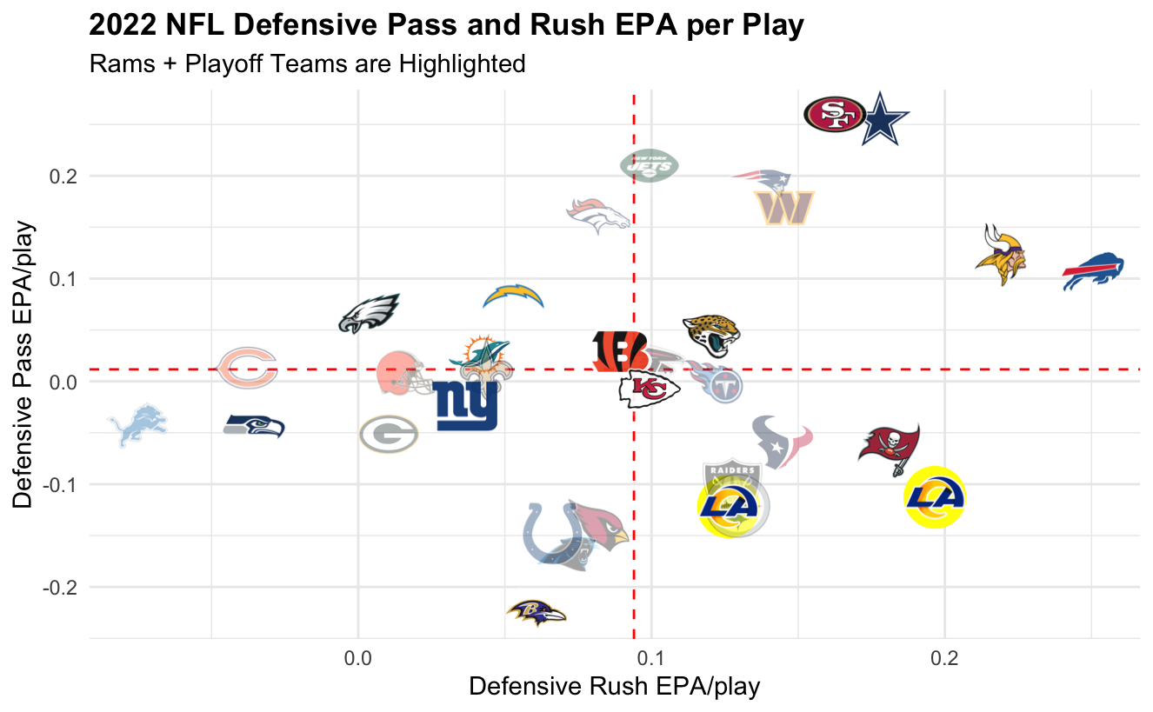
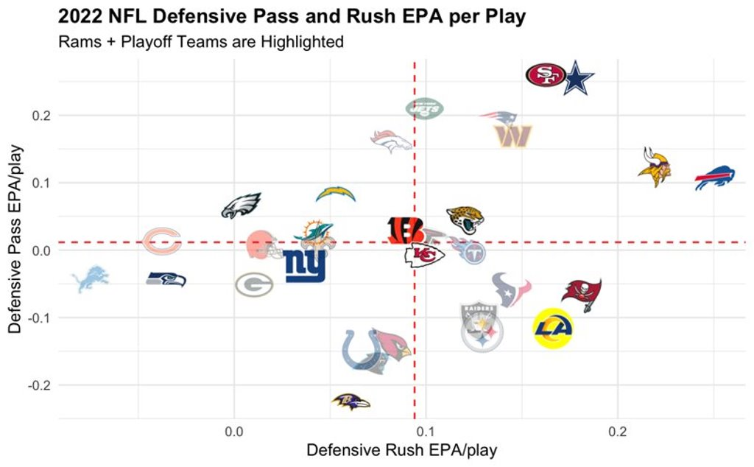
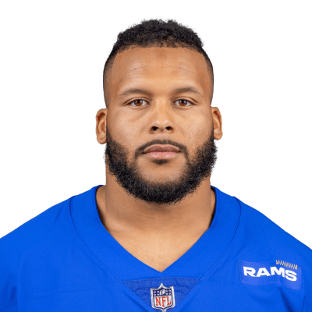

4th Quarter Crunch Time Defense
Notes:
Tim N

Slide 10
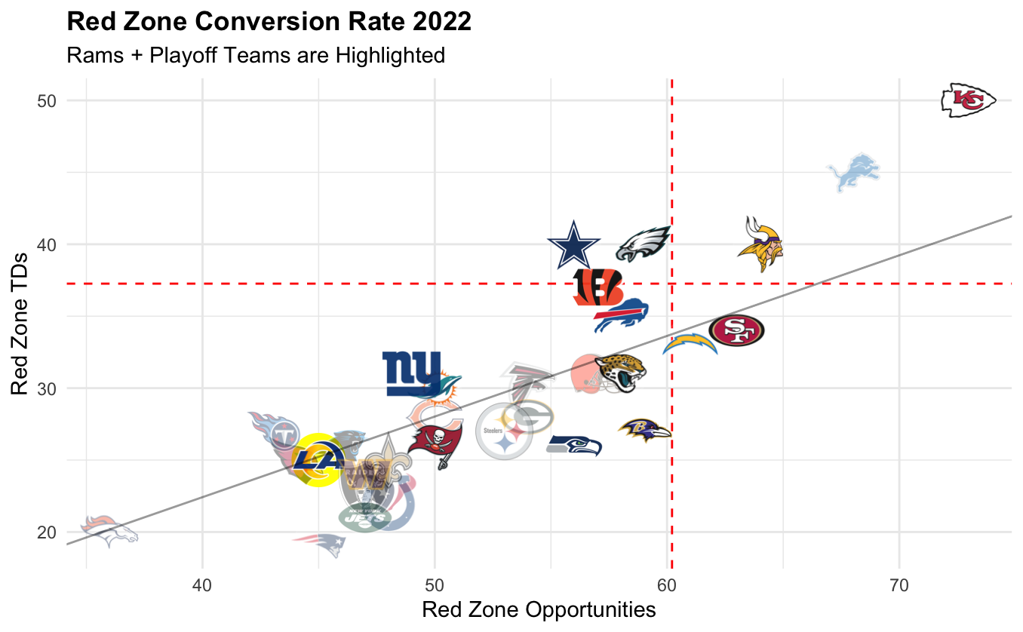
Red Zone TD Conversion Rate
Notes:
Tim B

Slide 11
Conclusions
Injuries weakened passing efficiency and rush defense
Performed poorly in the passing game on both sides of the ball
Dominated any gain from playoff level rush defense
Consider restructuring contracts to add depth along the margins
Star power leads to poor depth, which is necessary if stars are neutralized by strategy or injury
Add speed back + deep threat WRs to help get into Red Zone more
Prioritize corners + safeties on defense
Pass efficiency improved in new look offense
Have less of a reliance on one player
Notes:
Kevin

